Slide 1
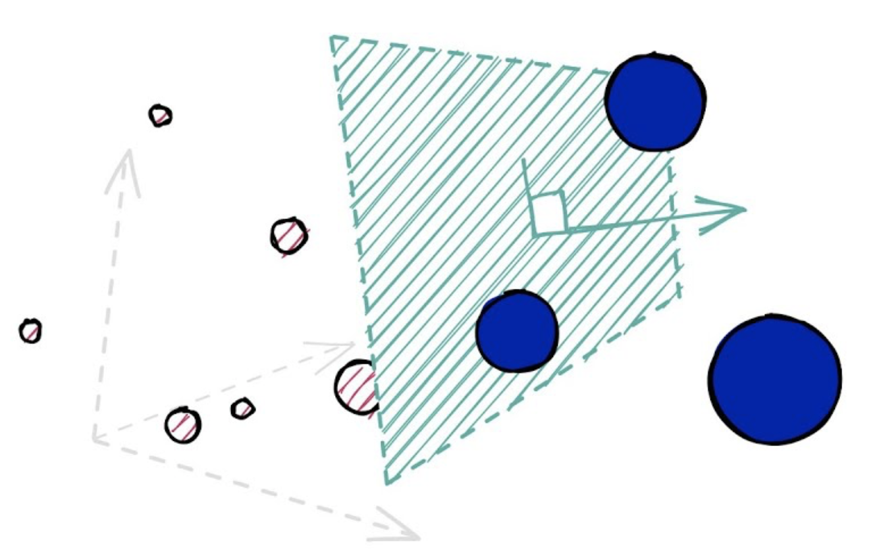
Similarity Search over High-Dimensional Data
Weekly Group Meeting
YAO Jing
22 Oct. 2021

Slide 2
Outline
Problem Definition
Existing Approaches
Existing Work
Research Direction
Open Source Tools

Slide 3
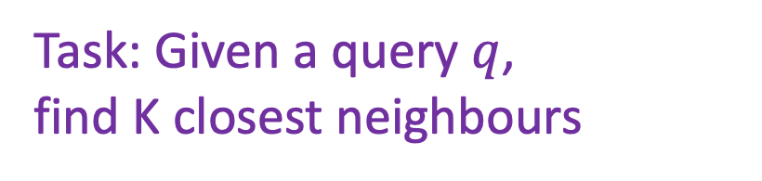
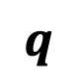
Problem definition
$$q$$
Task: Given a query $q$,
find K closest neighbours
Notes:
Similarity search is the most general term used for a range of mechanisms which share the principle of searching (typically, very large) spaces of objects where the only available comparator is the similarity between any pair of objects. This is becoming increasingly important in an age of large information repositories where the objects contained do not possess any natural order, for example large collections of images, sounds and other sophisticated digital objects. Nearest neighbor search and range queries are important subclasses of similarity search, and a number of solutions exist.

Slide 4
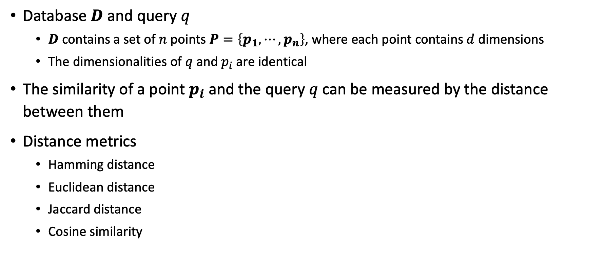
Problem definition
Database $D$ and query $q$
$D$ contains a set of $n$ points $P=\left\{p_{1},⋯,p_{n}\right\}$, where each point contains $d$ dimensions
The dimensionalities of $q$ and $p_{i}$ are identical
The similarity of a point $p_{i}$and the query $q$can be measured by the distance between them
Distance metrics
Hamming distance
Euclidean distance
Jaccard distance
Cosine similarity

Slide 5
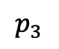
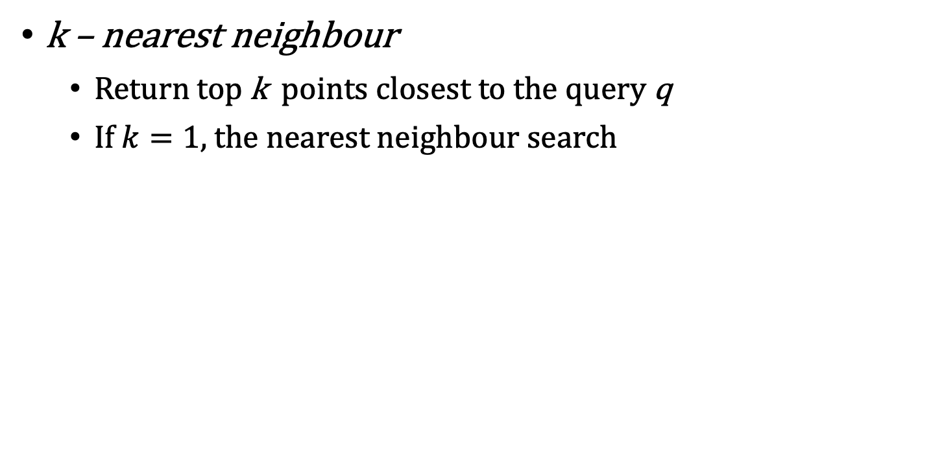
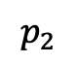
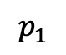
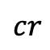
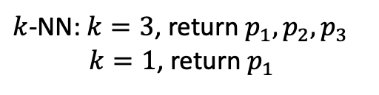
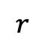
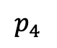
Similarity search
$$p_{2}$$
$$p_{3}$$
$$p_{4}$$
k – nearest neighbour
Return top k points closest to the query q
If $k=1$, the nearest neighbour search
$$p_{1}$$
$$cr$$
q
$$r$$
$k$-NN: $k=3$, return $p_{1},p_{2},p_{3}$
$k=1$, return $p_{1}$

Slide 6
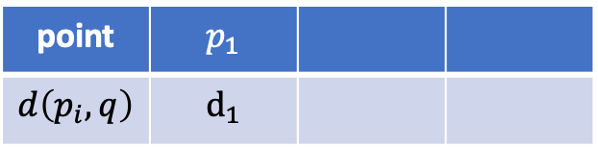
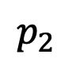
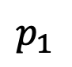
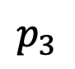
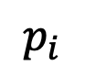
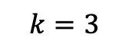
Naïve solution
$$p_{2}$$
$$p_{1}$$
$$q$$
$$p_{3}$$
$$p_{i}$$
point | $$p_{1}$$
$$d\left(p_{i},q\right)$$ | $$d_{1}$$
$$k=3$$

Slide 7
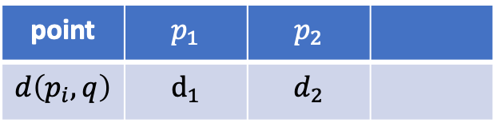
Naïve solution
$$p_{2}$$
$$p_{1}$$
$$q$$
$$p_{3}$$
$$p_{i}$$
point | $$p_{1}$$ | $$p_{2}$$
$$d\left(p_{i},q\right)$$ | $$d_{1}$$ | $$d_{2}$$
$$k=3$$

Slide 8
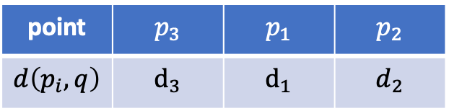
Naïve solution
$$p_{2}$$
$$p_{1}$$
$$q$$
$$p_{3}$$
$$p_{i}$$
point | $$p_{3}$$ | $$p_{1}$$ | $$p_{2}$$
$$d\left(p_{i},q\right)$$ | $$d_{3}$$ | $$d_{1}$$ | $$d_{2}$$
$$k=3$$

Slide 9

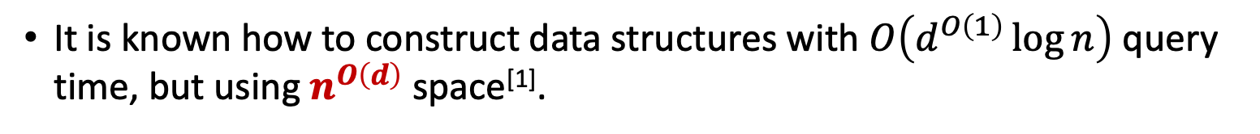
Naïve solution
$$p_{2}$$
$$p_{1}$$
$$q$$
$$p_{3}$$
$$p_{i}$$
Search overhead is $O({dn}^{2})$ !
It is known how to construct data structures with $O\left(d^{O\left(1\right)}\log{n}\right)$ query time, but using $n^{O\left(d\right)}$ space^{[1]}.
[1] Stefan Meiser. Point location in arrangements of hyperplanes. Information and Computation, 106(2):286–303, 1993.

Slide 10
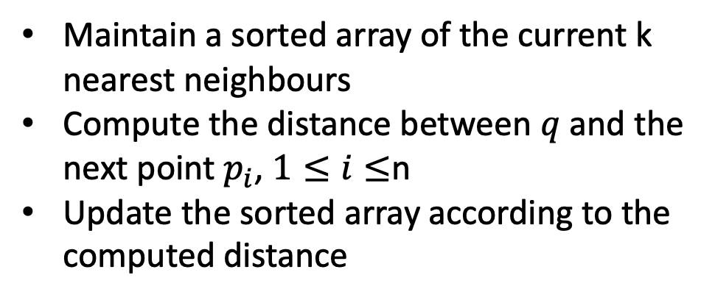

Naïve solution
$$p_{2}$$
$$p_{3}$$
$$p_{4}$$
Maintain a sorted array of the current k nearest neighbours
Compute the distance between $q$ and the next point $p_{i}$, $1≤i≤$n
Update the sorted array according to the computed distance
$$p_{1}$$
$$cr$$
q
$$r$$
$k$-NN: $k=3$, return $p_{1},p_{2},p_{3}$
$k=1$, return $p_{1}$
Search overhead is $O(dn^{2})$ !
It is known how to construct data structures with $O\left(d^{O\left(1\right)}\log{n}\right)$ query time, but using $n^{O\left(d\right)}$ space^{[1]}.
[1] Stefan Meiser. Point location in arrangements of hyperplanes. Information and Computation, 106(2):286–303, 1993.

Slide 11
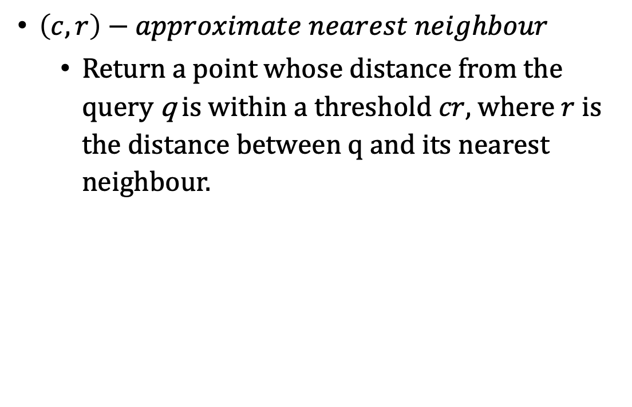

Approximate nearest neighbour
Idea: What if we got almost closest points?
$$p_{3}$$
$$p_{2}$$
$$p_{4}$$
$\left(c,r\right)−approximate nearest neighbour$
Return a point whose distance from the query q is within a threshold $cr$, where $r$ is the distance between q and its nearest neighbour.
$$p_{1}$$
$$cr$$
q
$$r$$
$\left(c,r\right)$-ANN: return $p_{1} or p_{2}$
It is hard to construct a polynomial-time algorithm for this task^{[2]}!
[2] Alexandr Andoni, Piotr Indyk, and Ilya Razenshteyn, “Approximate nearest neighbor search in high dimensions,” in Proc. of the International Congress of Mathematicians, 2018.

Slide 12
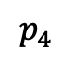
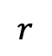
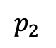
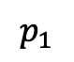
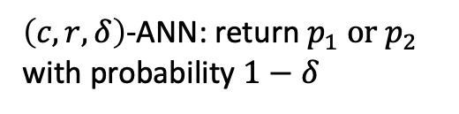
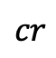
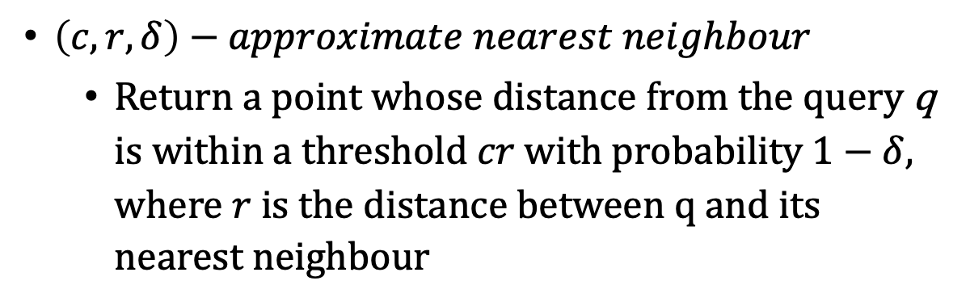
Approximate nearest neighbour
Idea: What if we got almost closest points?
$$p_{3}$$
$$p_{4}$$
$$p_{2}$$
$\left(c,r,δ\right)−approximate nearest neighbour$
Return a point whose distance from the query q is within a threshold $cr$ with probability $1−δ$, where $r$ is the distance between q and its nearest neighbour
$$p_{1}$$
$$cr$$
q
$$r$$
$\left(c,r,δ\right)$-ANN: return $p_{1} or p_{2}$ with probability $1−δ$
The probability of failure $δ$ of the data structure can be reduced by independently repeating the process several times^{[2]}.
[2] Alexandr Andoni, Piotr Indyk, and Ilya Razenshteyn, “Approximate nearest neighbor search in high dimensions,” in Proc. of the International Congress of Mathematicians, 2018.

Slide 13
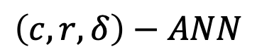
Design challenges
Efficiency
Query time and data structure construction/update time
How to balance?
The failure probability of finding the exact nearest neighbour
The space complexity of the data structures
Accuracy
Space
Security
Query privacy and database privacy
$$\left(c,r,δ\right)−ANN$$

Slide 14
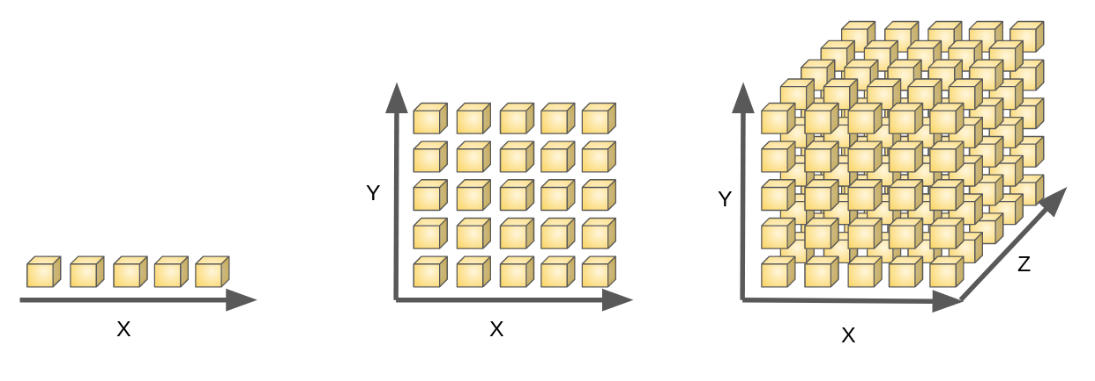
Challenge 1 – Curse of dimensionality
1 dimension: 5 points
2 dimensions: 25 points
3 dimensions: 125 points
The number of points to be accessed in the database grows exponentially with the underlying dimensionality.

Slide 15
Challenge 2 – Massive database
Internet
Google processes about 4.5 million searches every second
Social media
Every minute, 511,200 tweets are tweeted on Twitter
Communication
The number of emails sent throughout the globe is approximately 188 million each minute
Services
Over 390,030 apps are downloaded from the various app store every minute
How to build a data structures with sublinear query time and sublinear space?
https://www.takeo.ai/can-you-guess-how-much-data-is-generated-every-day/

Slide 16
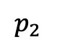
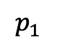
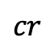
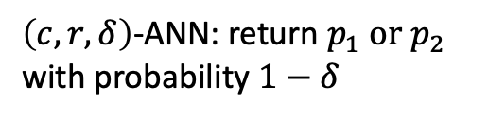
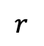
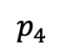
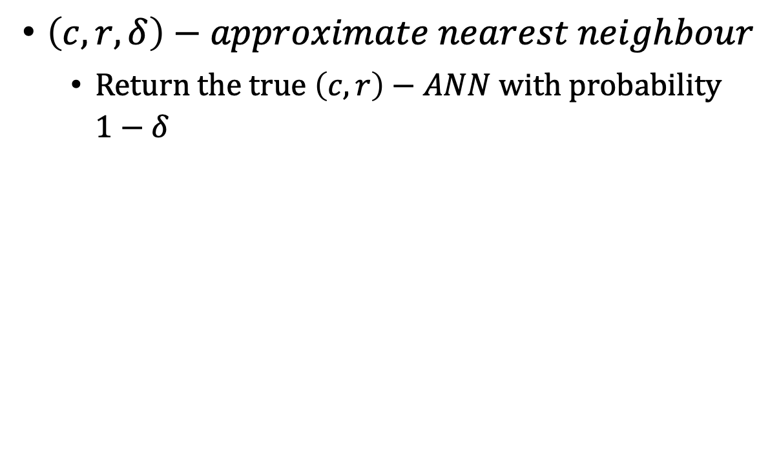
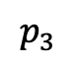
Approximate nearest neighbour
$$p_{3}$$
$$p_{4}$$
$$p_{2}$$
$$p_{1}$$
$$cr$$
q
$\left(c,r,δ\right)−approximate nearest neighbour$
Return the true $\left(c,r\right)−ANN$ with probability $1−δ$
$$r$$
$\left(c,r,δ\right)$-ANN: return $p_{1} or p_{2}$ with probability $1−δ$
The only difference between $\left(c,r\right)−ANN$ and $\left(c,r,δ\right)−ANN$ is that $\left(c,r,δ\right)−ANN$ uses random bits while constructing the data structure.
The probability of failure $δ$ of the data structure can be reduced by independently repeating the process several times^{[2]}.
[2] Alexandr Andoni, Piotr Indyk, and Ilya Razenshteyn, “Approximate nearest neighbor search in high dimensions,” in Proc. of the International Congress of Mathematicians, 2018.
Notes:
\delta is not negligible

Slide 17
Existing work
ANN-approaches
Space partitioning based approach
locality-sensitive hashing
Encoding
Tree
Graph based approach
Privacy-preserving ANN approaches
Searchable encryption
Homomorphic encryption + garbled circuits

Slide 18
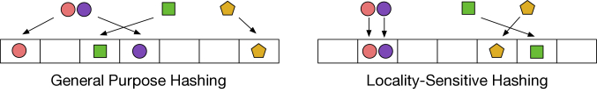
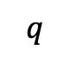
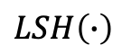
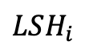
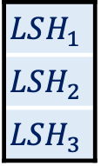
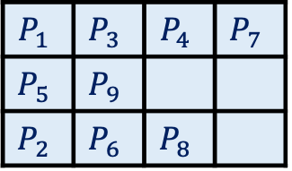
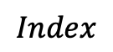
Locality-sensitive hashing (LSH)
LSH makes the hash collision probabilities of similar data higher than those of dissimilar data.
General approach
$$LSH\left(∙\right)$$
$$LSH_{1}$$
$$LSH_{2}$$
$$LSH_{3}$$
$$P_{1}$$ | $$P_{3}$$ | $$P_{4}$$ | $$P_{7}$$
$$P_{5}$$ | $$P_{9}$$
$$P_{2}$$ | $$P_{6}$$ | $$P_{8}$$
$$q$$
$$LSH_{i}$$
$$Index$$
A sublinear-time approach, but with false negatives.
It is highly sensitive to the curse of dimensionality^{[3]}.
[3] https://www.pinecone.io/learn/vector-indexes/.
Notes:
For 90% recall we use 64d, which is 64*128 = 8192.

Slide 19
Research direction 1 - reduce false negatives
[4] Alexander Wei. "Optimal Las Vegas Approximate Near Neighbors in ℓp." In Proc. of the Thirtieth Annual ACM-SIAM Symposium on Discrete Algorithms. 2019.
[5] Josh Alman, Timothy M. Chan, and Ryan Williams. "Faster deterministic and Las Vegas algorithms for offline approximate nearest neighbors in high dimensions." in Proc of the Fourteenth Annual ACM-SIAM Symposium on Discrete Algorithms. 2020.

Slide 20
Research Direction 2 – improve search efficiency
[6] Lu Kejing, et al. "VHP: approximate nearest neighbor search via virtual hypersphere partitioning." in Proc. of VLDB. 2020.

Slide 21
Encoding
Learning to hash
Product quantization
Idea: embed all the data points to a low-dimensional space in a
pairwise-distance preserving way.

Slide 22
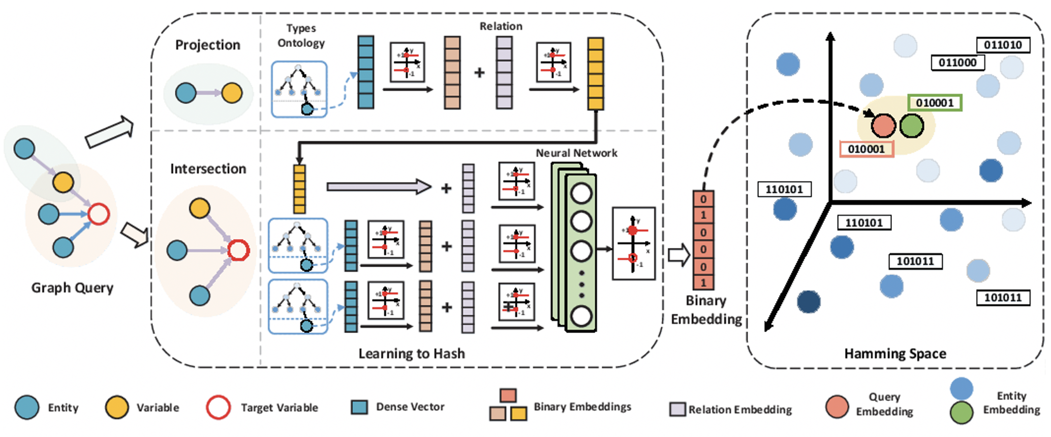
Learning to hash
Idea: embed data point space to a k-dimensional Hamming cube according to the data point distribution while minimizing some objective function, e.g., neighbourhood preservation or distance distortion
Goal: preserve local neighbourhoods while separating non-neighbours with lowest possible number of hash bits.

Slide 23
Research direction 3 - reduce dimensionality of Hamming cube
[7] Shi Shaoyun, et al. "Beyond User Embedding Matrix: Learning to Hash for Modeling Large-Scale Users in Recommendation." in Proc. of ACM SIGIR. 2020.
[8] Chen Yong, et al. "Long-tail hashing." Proceedings of the 44th International ACM SIGIR. 2021.

Slide 24
Research direction 3 - reduce dimensionality of Hamming cube
[7] Shi Shaoyun, et al. "Beyond User Embedding Matrix: Learning to Hash for Modeling Large-Scale Users in Recommendation." in Proc. of ACM SIGIR. 2020.
[8] Chen Yong, et al. "Long-tail hashing." Proceedings of the 44th International ACM SIGIR. 2021.
Achieve higher efficiency than LSH at the cost of relinquishing the theoretical guarantees^{[9]}.
[9] Parikshit Ram and Kaushik Sinha. "Revisiting kd-tree for nearest neighbor search.” in Proc. of sigkdd. 2019.

Slide 25
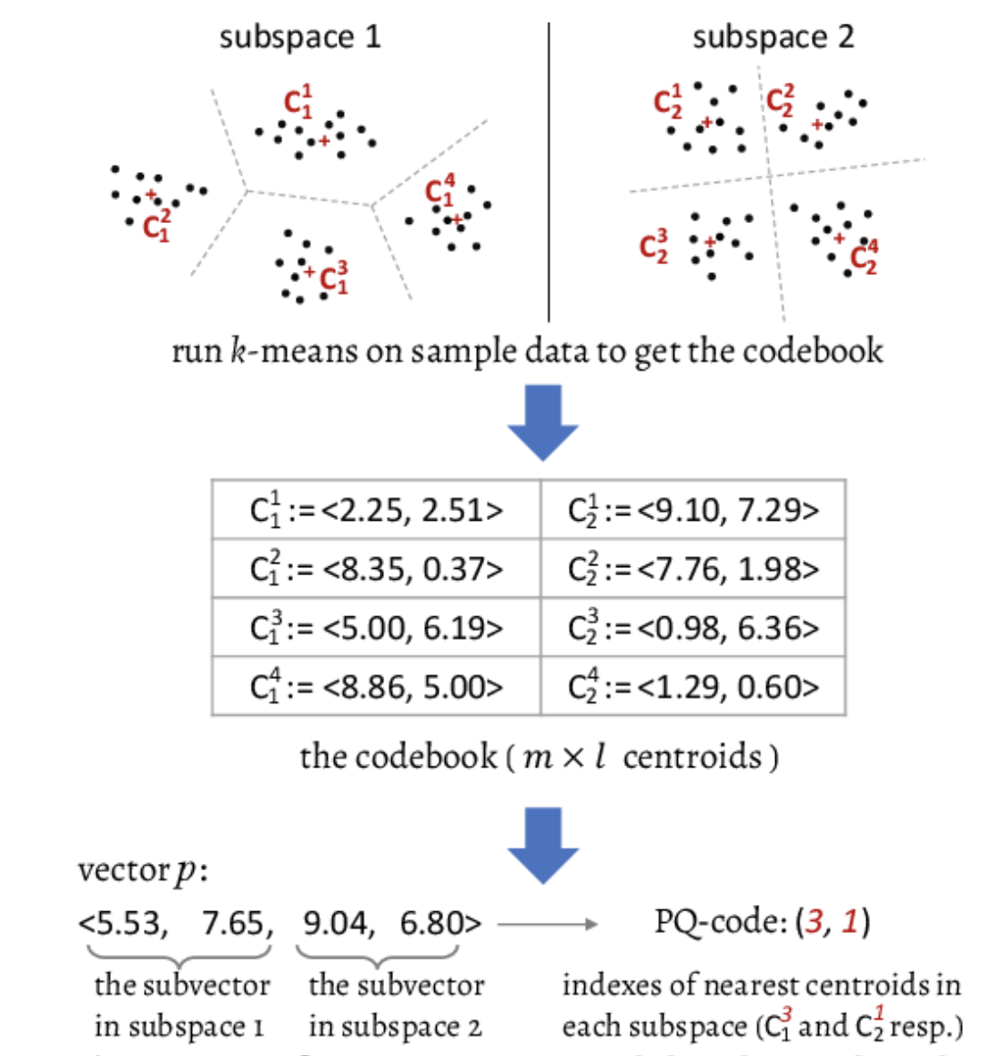
Product quantization
Idea: decomposes the original vector space into the Cartesian product of k lower dimensional subspaces, and performs vector quantization in each subspace separately. A vector is then represented by a short code composed of its subspace quantization indices.
Advantage: Tiny space consumption^{[10]} - smaller than learning to hash
Drawback: It is also hard to tell how well this technique work and when it might fail (theoretical guarantees)^{[9]}.
[10] https://szudseg.github.io/kdd21-tutorial-high-dim-simqp/

Slide 26
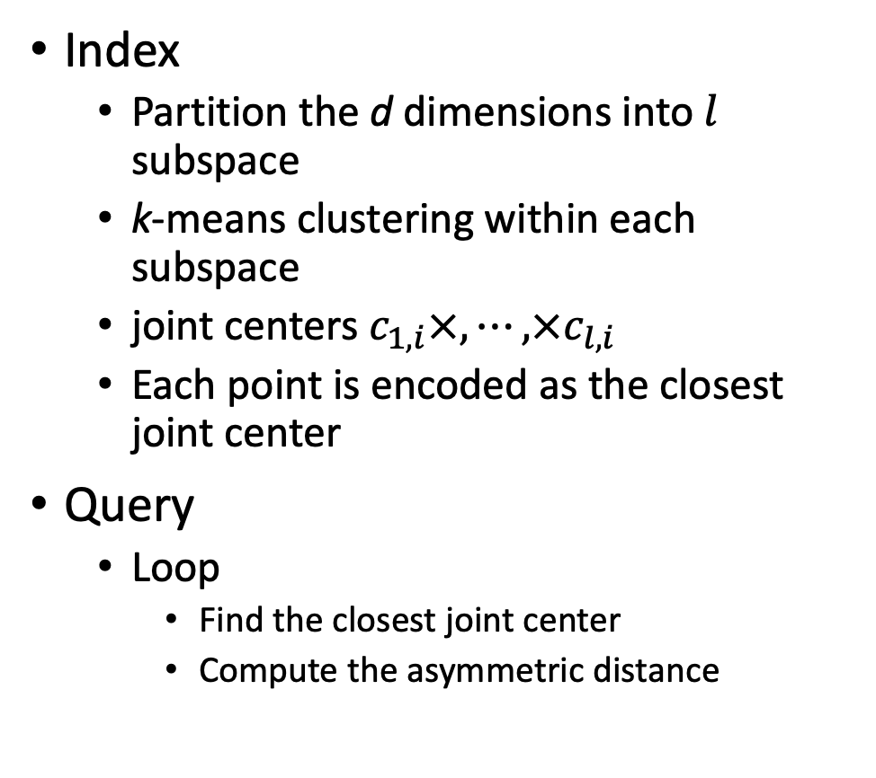
Product quantization
Index
Partition the d dimensions into $l$ subspace
k-means clustering within each subspace
joint centers $c_{1,i}×,⋯,×c_{l,i}$
Each point is encoded as the closest joint center
Query
Loop
Find the closest joint center
Compute the asymmetric distance
It is also hard to tell how well this technique work and when it might fail (theoretical guarantees).

Slide 27

Tree
Naïve idea: KD-tree
Hierarchically partition the whole space into partitions that covers the whole space
Build the tree according to the partitions
A sublinear-time approach, but non-trivial to extend to high-dimensional data^{[7]}

Slide 28

Tree
Idea: random projection tree (RPTree^{[11]})
Randomly partition the whole space into partitions that covers the whole space
Build the tree according to the partitions
It has been implemented in ANNOY^{[12]} used at Spotify for music recommendations
[11] Sanjoy Dasgupta, and Yoav Freund, "Random projection trees and low dimensional manifolds," in Proc. of TC. 2008.
[12] https://github.com/spotify/annoy
Notes:
random-projection trees adapts to the intrinsic dimensionality
better adaptivity to the intrinsic dimension leads to better search performance,

Slide 29

Tree
$$k=2$$
Idea: Hierarchical k-means tree
perform k-means clustering recursively
Drawback: high time cost in tree construction^{[13]}
[13] Muja, Marius, and David G. Lowe. "Fast approximate nearest neighbors with automatic algorithm configuration." VISAPP (1)2.331-340 (2009): 2.

Slide 30
Research direction 4 – improve search efficiency
[14] Parikshit Ram, and Kaushik Sinha. "Revisiting kd-tree for nearest neighbor search." in Proc. of acm sigkdd. 2019.
[15] Ville Hyvönen, et al. "Fast nearest neighbor search through sparse random projections and voting." in Proc. of IEEE International Conference on Big Data (Big Data). 2016.

Slide 31

Graph based approach
HNSW
Split the graph into layers(fewer elements at higher levels)
Search starts for the top layer. Greedy routing at each level and descend to the next layer
Maximum degree is capped while paths $\sim$ log(N)
It has been implemented by Facebook (Faiss^{[16])} and Microsoft (HNSW.Net^{[17]})
[16] https://github.com/facebookresearch/faiss
[17] https://libs.garden/csharp/Microsoft/HNSW.Net
Notes:
Hundreds of millions points in dataset only four points at the top of the layer

Slide 32

Privacy-preserving ANN
Threat model
Malicious users
Intend to infer the information about the database beyond the query results
Semi-honest servers (data owners)
Desire to infer the queries and their results
Design goal
Efficiency – comparable to plaintext approach (sublinear-time)
Security – reveal nothing but the results
Communication overhead - $O\left(1\right)$is preferable

Slide 33







Searchable encryption based approaches
$$LSH\left(∙\right)$$
$$LSH_{1}$$
$$LSH_{2}$$
$$LSH_{3}$$
$$P_{1}$$ | $$P_{3}$$ | $$P_{4}$$ | $$P_{7}$$
$$P_{5}$$ | $$P_{9}$$
$$P_{2}$$ | $$P_{6}$$ | $$P_{8}$$
$$q$$
$$LSH_{i}$$
$$Index$$
Client
Server
Idea: follow searchable encryption framework to encrypt index
Drawback:
Security concerns (search pattern + access pattern)
Accuracy (especially in high-dimensional space)

Slide 34
Research direction 5 – leakage abuse attacks
[18] Evgenios M. Kornaropoulos, Charalampos Papamanthou, and Roberto Tamassia. "The state of the uniform: attacks on encrypted databases beyond the uniform query distribution." in Proc. of IEEE SP. 2020.
[19] Evgenios M. Kornaropoulos, Charalampos Papamanthou, and Roberto Tamassia. "Data recovery on encrypted databases with k-nearest neighbor query leakage." in Proc. of IEEE SP. 2019.

Slide 35
Research direction 6 – security enhancement
[20] Yuan Xingliang, et al. "Privacy-preserving similarity joins over encrypted data." IEEE Transactions on Information Forensics and Security. 2017: 2763-2775.
[21] Alexandra Boldyreva, and Tianxin Tang. “Privacy-Preserving Approximate k-Nearest-Neighbors Search that Hides Access, Query and Volume Patterns.” in Proc. of PETS. 2021.

Slide 36











Research direction 5 – security enhancement
Search pattern protection
$$LSH\left(∙\right)$$
Queried before?
$$LSH_{1}$$
$$LSH_{2}$$
$$LSH_{3}$$
$$P_{1}$$ | $$P_{3}$$ | $$P_{4}$$ | $$P_{7}$$
$$P_{5}$$ | $$P_{9}$$
$$P_{2}$$ | $$P_{6}$$ | $$P_{8}$$
N
$$q$$
$$LSH_{i}$$
$$LSH_{i}$$
$$Index$$
Y
Server
$$LSH_{2}$$
$$LSH_{3}$$
$$P_{5}$$ | $$P_{9}$$
$$P_{2}$$ | $$P_{6}$$ | $$P_{8}$$
$$Cache$$
Search result
$$⨂$$
Client
[20] Yuan, Xingliang, et al. "Privacy-preserving similarity joins over encrypted data." IEEE Transactions on Information Forensics and Security. 2017: 2763-2775.

Slide 37

Research direction 6 – performance improvement
Accuracy improvement
System architecture
Ideal: k-means clustering + homomorphic encryption + garbled circuits + secret sharing
Drawback: high computation overhead
[22] Chen, Hao, et al. "{SANNS}: Scaling up secure approximate k-nearest neighbors search." in Proc. of USENIX Security. 2020.

Slide 38


Research direction 6 – performance improvement
Search efficiency improvement
Index building
System model
Idea: distributed point function + secret sharing
Performance: the search latency is about 21.3s (32 CPUs) while the size of database achieves about 10,000,000
[23] Servan-Schreiber, Sacha, Simon Langowski, and Srinivas Devadas. "Lightweight Private Similarity Search." ePrint. 2021.

Slide 39
Open source tools
Faiss
https://github.com/facebookresearch/faiss
ANNOY
https://github.com/spotify/annoy
Milvus
https://github.com/milvus-io/milvus

